Slide 1
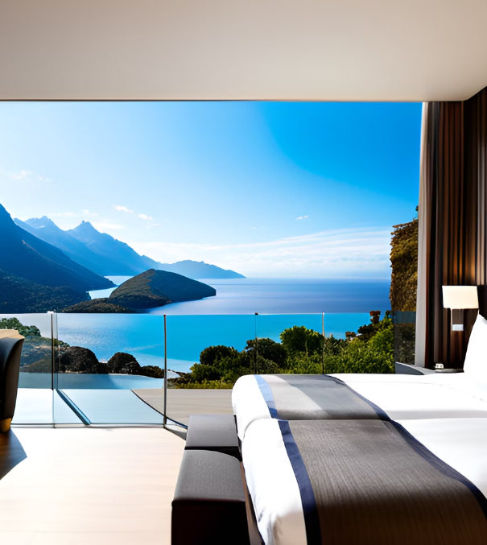
Discovering Unique Stays: A Travel Restaurant Brochure

Slide 2

Welcome to our Travel Restaurant Brochure
We are excited to introduce you to our unique project that combines the best of travel and food. Our brochure offers a curated selection of hotels in popular and offbeat destinations, along with packages and offers that cater to your specific needs. What sets us apart is our certification process that ensures that all our hotels are of the highest quality and meet our strict standards.

Slide 3
Our travel restaurant brochure offers a unique experience by providing certified hotels for stay in popular and offbeat destinations, with customized packages and offers that cater to the needs of our customers.

Slide 4

Our Certification Process
At our travel restaurant, we take pride in ensuring that our customers have the best experience possible. That's why we have a rigorous certification process for all of our partner hotels.
Our process includes a thorough inspection of the hotel's facilities, amenities, and customer service standards. We also verify that the hotel meets all necessary safety and cleanliness regulations.
Once a hotel has passed our certification process, we work closely with them to ensure that they maintain our high standards. This includes regular check-ins and customer feedback surveys.

Slide 5



Packages and Offers
Luxury Packages
Our luxury packages include stays at 5-star hotels and resorts in popular destinations such as Bali, the Maldives, and Venice. These packages come with exclusive offers such as spa treatments, private tours, and gourmet dining experiences.
Adventure Packages
For the adventurous traveler, we offer packages that include stays in offbeat destinations such as the Amazon rainforest, the Sahara desert, and the Himalayas. These packages come with activities such as hiking, wildlife safaris, and cultural experiences.

Slide 6
Certification Process
All of our hotels are certified to ensure that they meet our high standards of quality and safety. We conduct thorough inspections and audits to make sure that our customers have a comfortable and secure stay.
Offers
We have a range of offers available for our customers, including discounts for early bookings, loyalty rewards, and referral bonuses. Our packages also include complimentary breakfast and airport transfers.

Slide 7
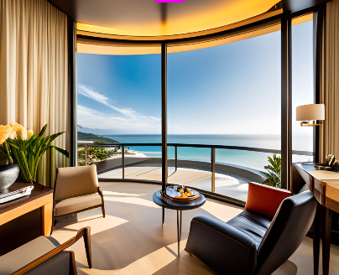
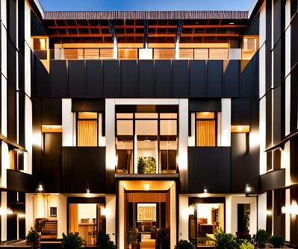

Hotels in Popular Destinations
Our travel restaurant brochure offers a wide range of hotels in popular destinations. Each hotel is carefully selected and certified by our team to ensure the best possible experience for our customers.Whether you're looking for a luxurious stay in a five-star hotel or a cozy bed and breakfast, we have options to suit every budget and preference.
Packages and Offers
We offer a variety of packages and special offers to make your stay even more enjoyable. From family packages to family-friendly deals, we have something for everyone.

Slide 8

Discover Hidden Gems
Experience the local culture and charm of offbeat destinations with our certified hotels.

Slide 9
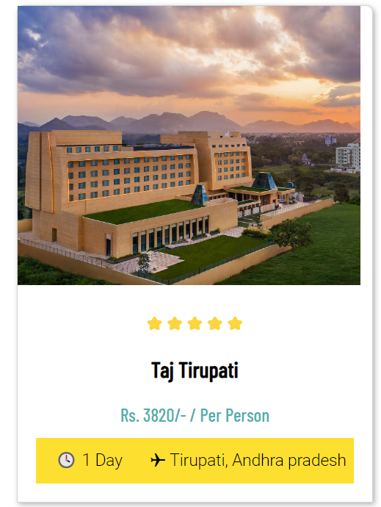
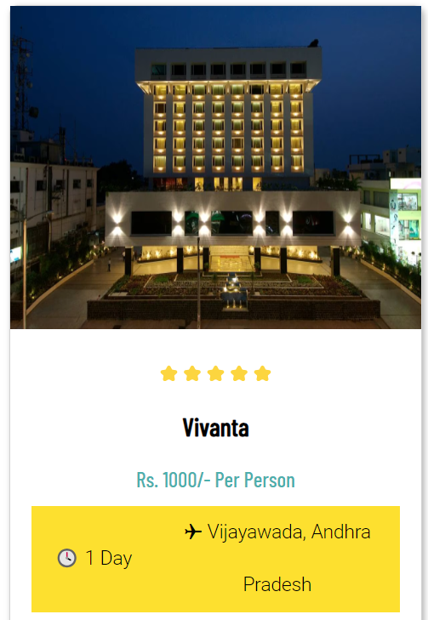
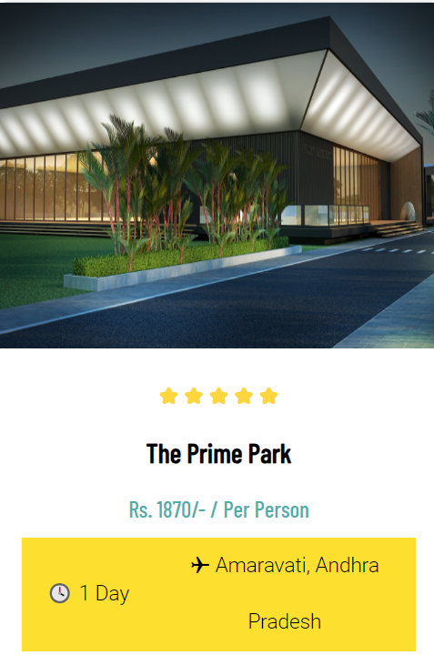

Slide 10
Experience the World with Confidence
Our certified hotels, unique offerings, and easy booking process ensure that you have a stress-free and enjoyable travel experience. Book your next adventure with us today!

